Slide 1
CPU Scheduling with Multiple CPU Burst Rates
James Naurot
John Wangari

Slide 2
CPU Scheduling Algorithms
First Come First Serve
Round Robin
Priority
Multi-Level Feedback Queue

Slide 3
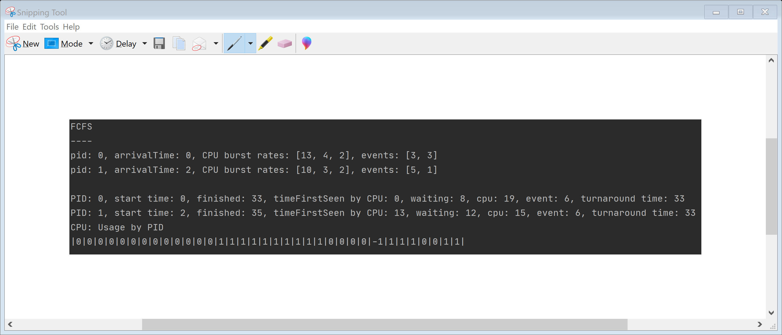
First Come First Served
Process at head of Ready Queue is placed in Running Queue until completion of Burst Rate

Slide 4
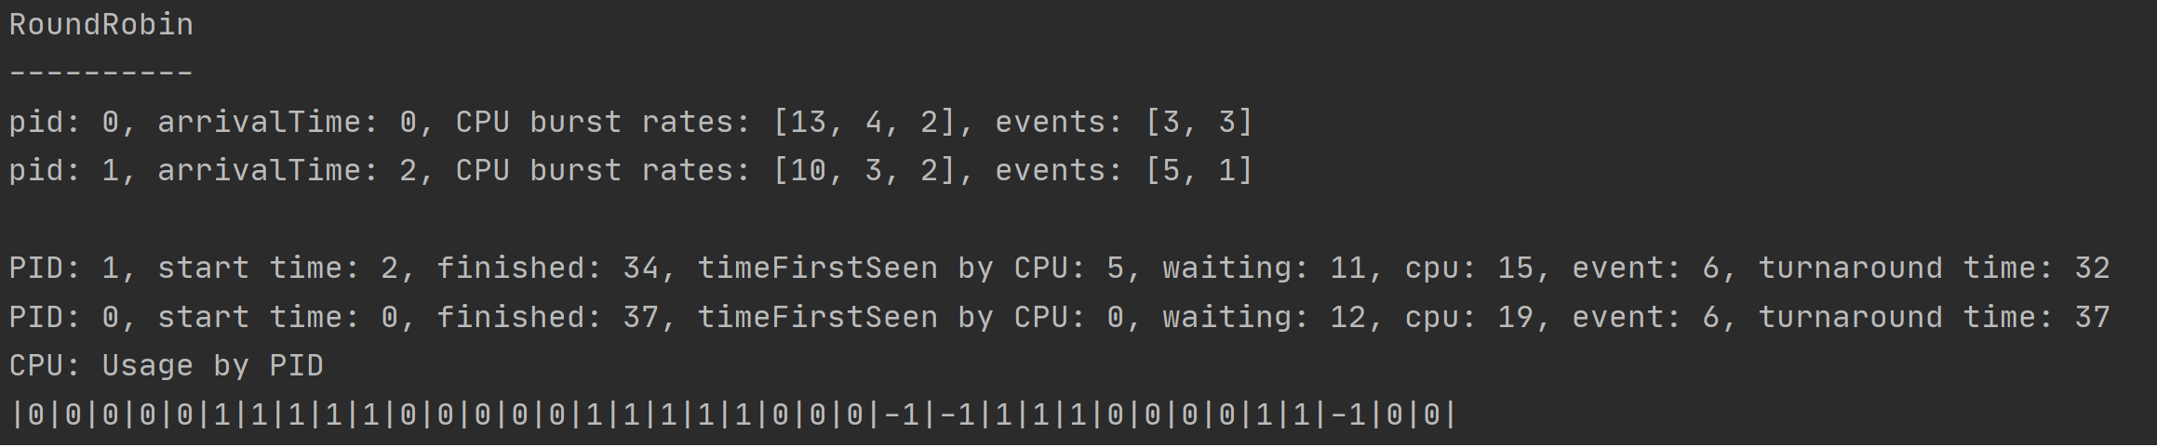
Round Robin
Process at head of Ready queue is given CPU until either
Process completes burst rate
Quanta expired

Slide 5
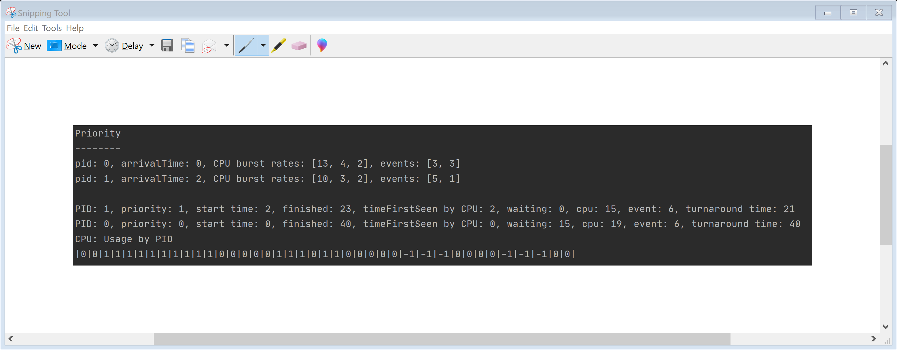
Priority Queue
Process inserted into Ready Queue based upon priority
Process at head of Ready queue is inserted into Running Queue
Process remains in Running Queue until either
Process completes
Process pre-empted by higher priority process

Slide 6
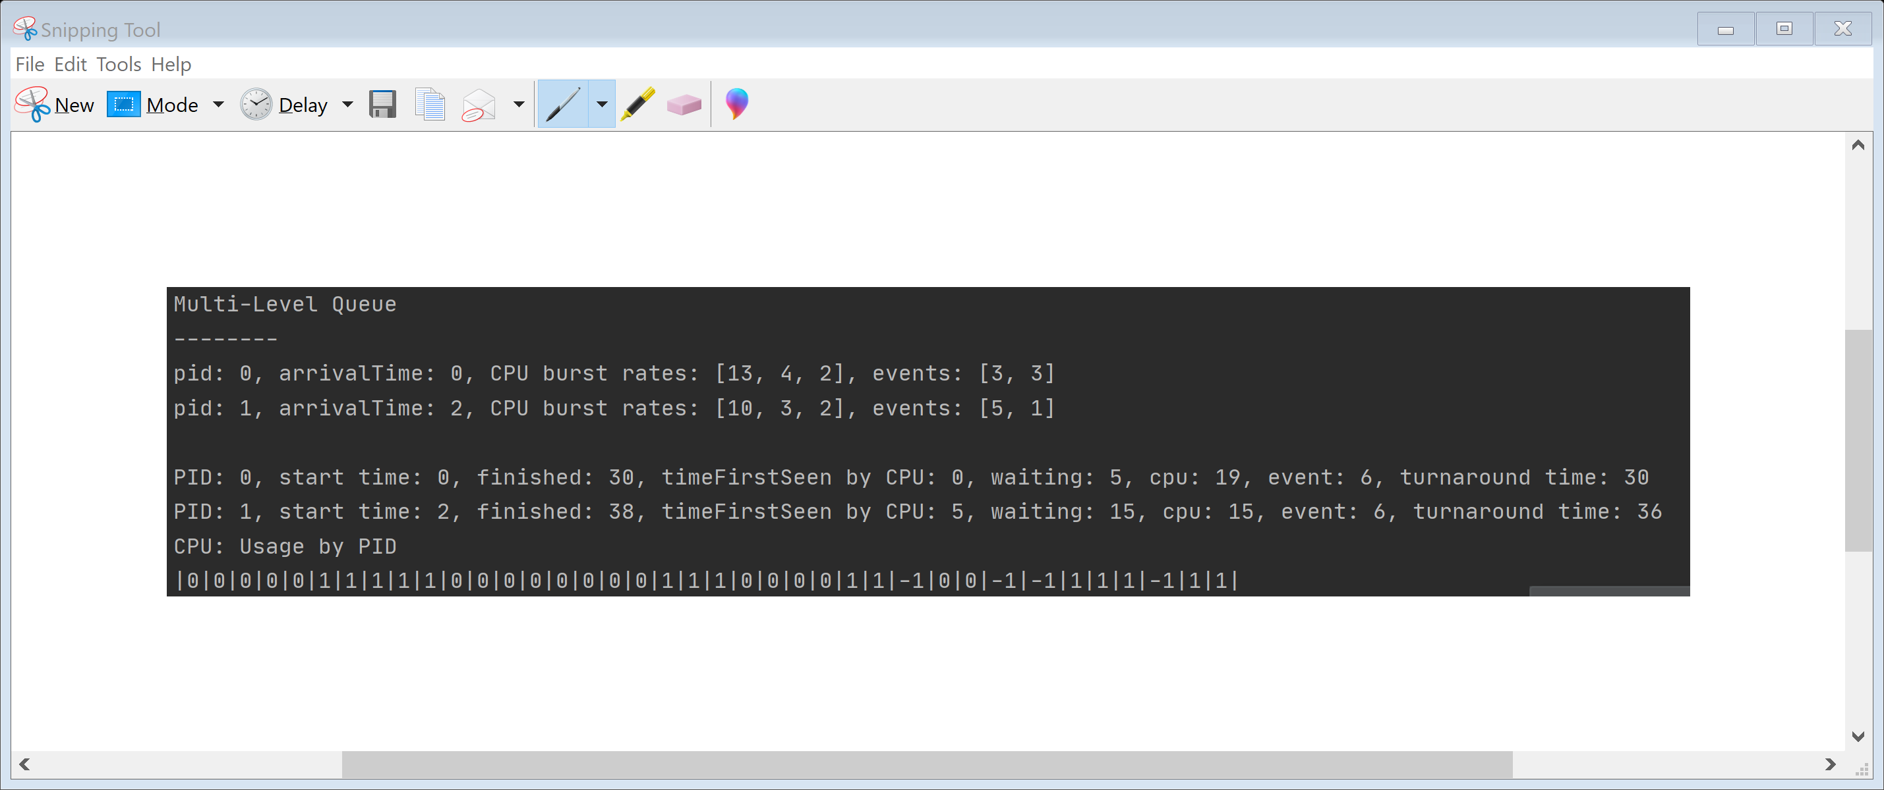
Multi-Level Feedback Queue
Process is brought into Running Queue from head of Ready Queue
Process continues in Running Queue until
Time Quanta expires
Process Finishes burst rate
Pre-empted by higher priority process

Slide 7
Things We Didn’t Consider
Multi-Level Queue is implemented only with Round Robin
Events are strictly non-competing resources, such as interrupts
We didn’t consider I/O
I/O queues
Deadlock
Starvation

Slide 8
References
https://www.tutorialspoint.com/operating_system/os_process_scheduling_algorithms.htm
https://www.pearson.com/us/higher-education/product/Stallings-Operating-Systems-Internals-and-Design-Principles-8th- s
https://www.geeksforgeeks.org/cpu-scheduling-in-operating-systems/

